Slide 1
If the Sky is Always Falling Learn How to Fly
My infosec and mental health journey

Slide 2
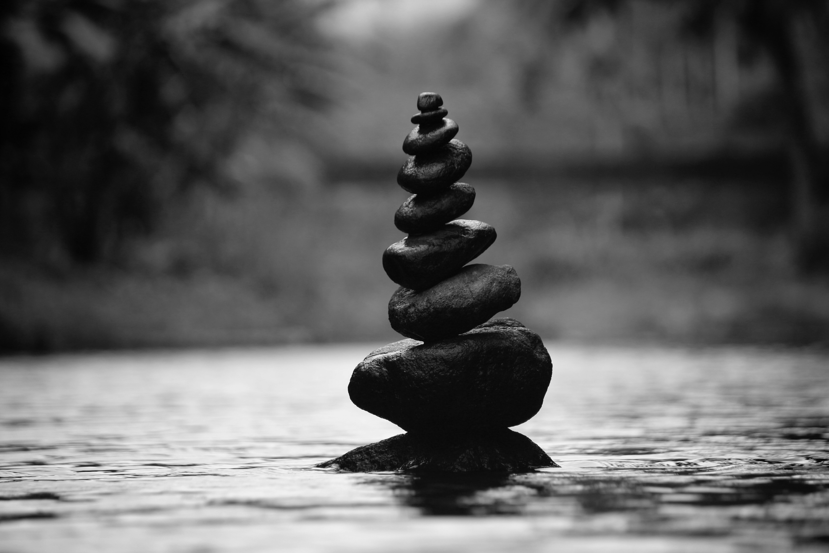
Breathe
Notes:
Take a seat with your feet on the ground
Take some breath deep breaths in
If you’d like you can close your eyes
With your breaths out focus on where you feel it
No bring your attention back to my voice and when you’re ready slowly open your eyes

Slide 3

Who I am
Red teamer
Work in high pressure environments
Handle my stress with sugar

Slide 4

Who I am NOT
Therapist
Trained mental health professional
Notes:
Always seek help from a trained medical professional

Slide 5

The sky is not always falling
Problems were here yesterday and they'll by here tomorrow
“But it ain't no world tour if I'm lying in a hearse” - juice WRLD
Let’s fight against this starting with ourselves
Notes:
We can’t win if we’re burned out

Slide 6
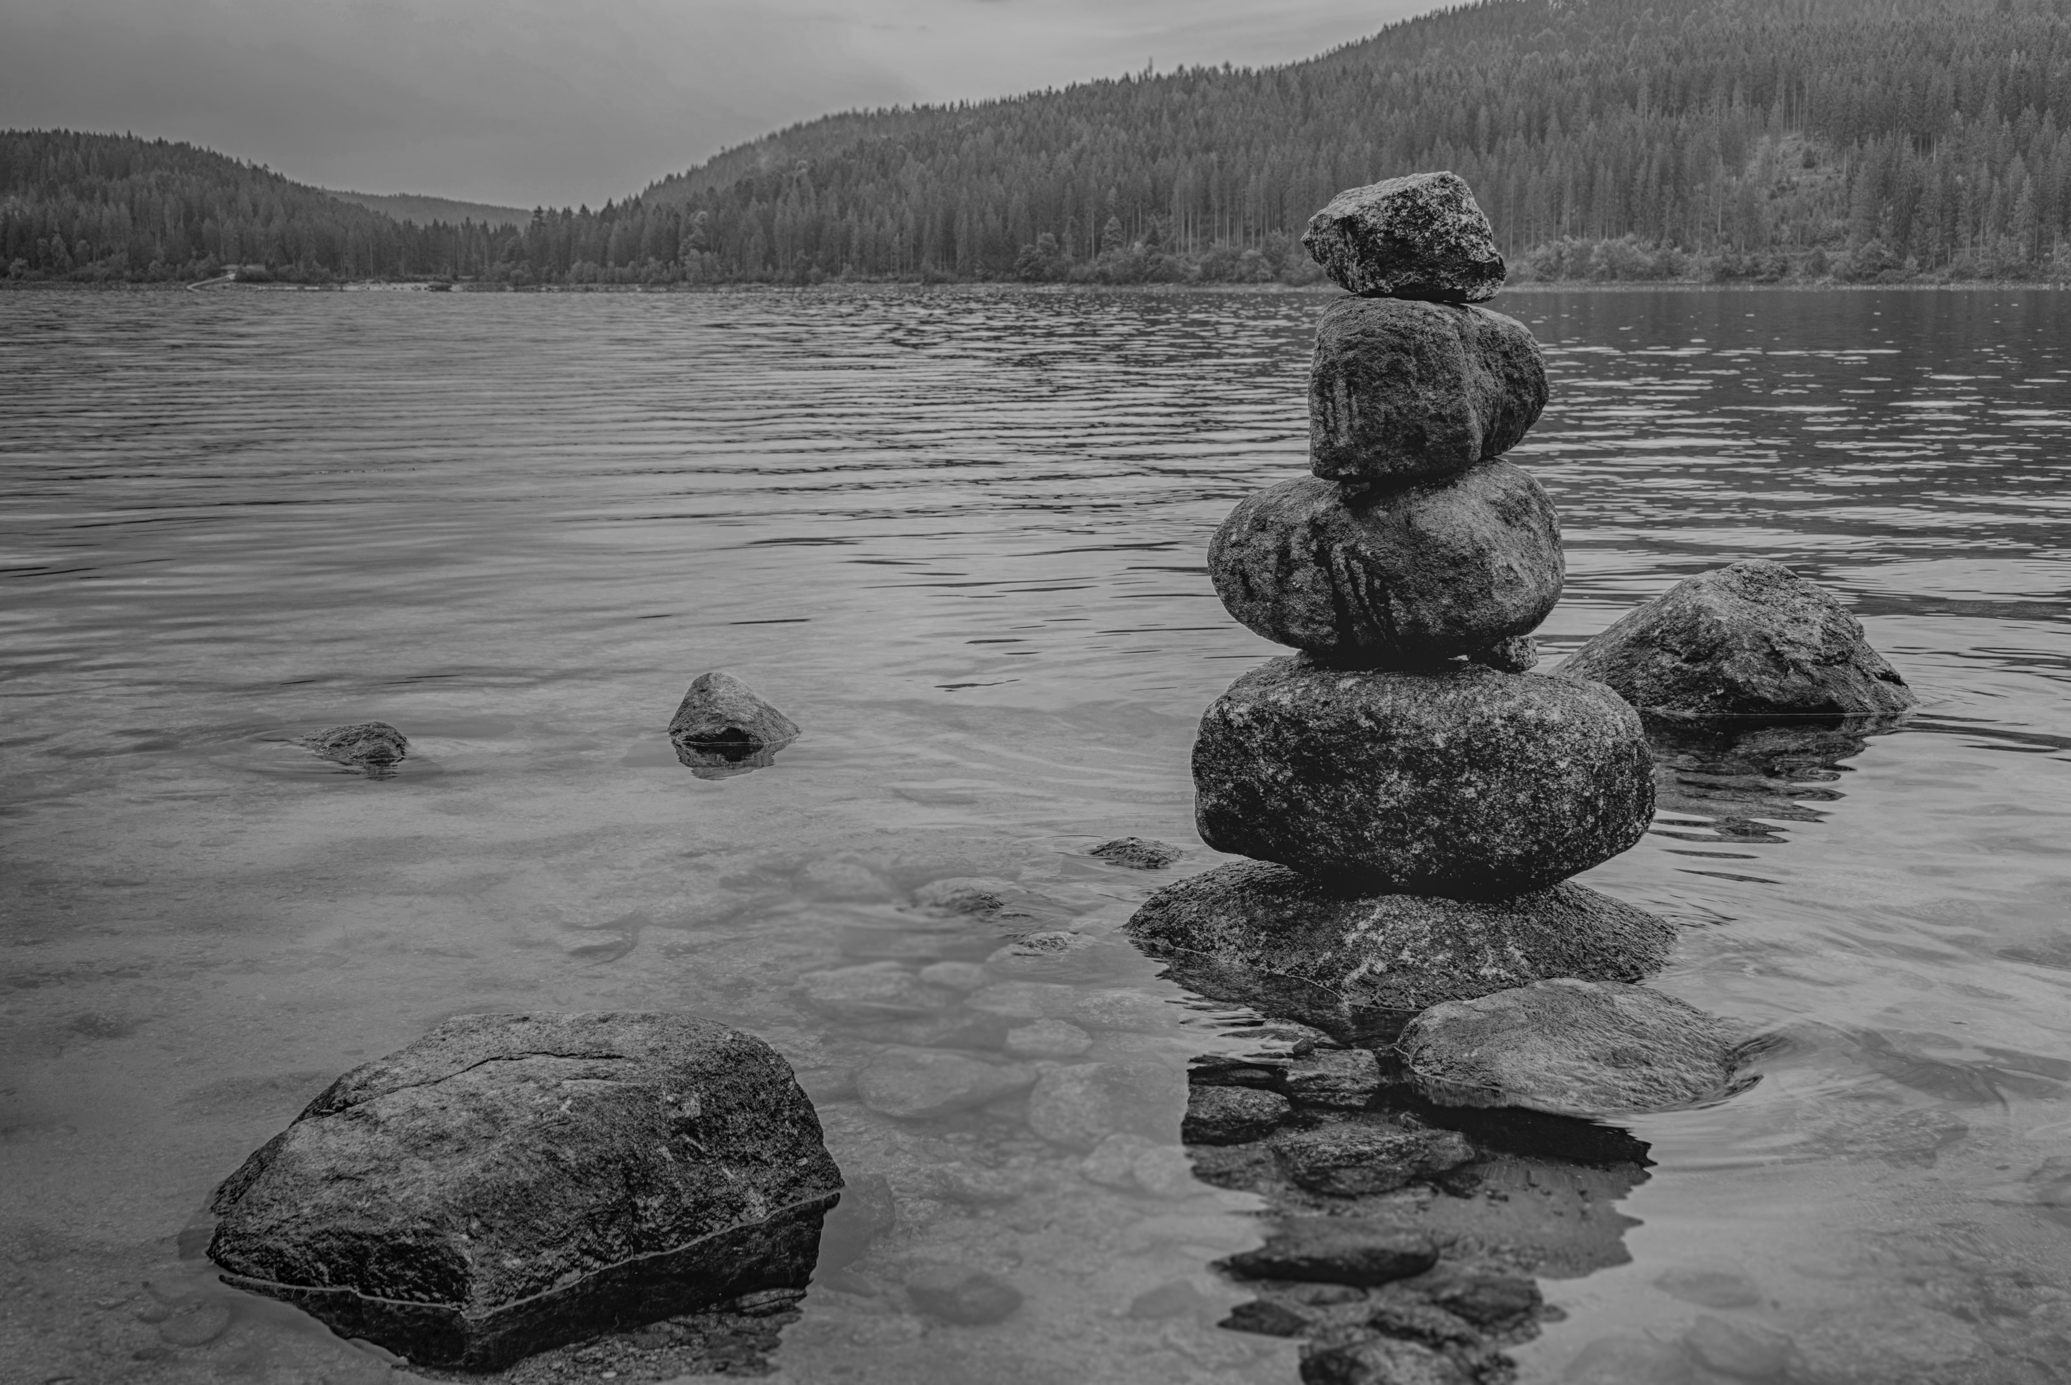
My fails
Essentializing my work
Not setting limits/Overextending myself
No self-care
Multi-tasking
My phone addiction
Burn out (guilt)
Notes:
- Essentializing my work: My value comes from my output
- Not setting limits, Overextending myself:: Yeah I'll take that meeting at 7pm on a Friday
- Not taking care of myself: If I just work on this a little longer I will succeed, screw that work out, screw that date night, screw that board game night, screw me
- Multitasking: This is stupid
- My phone addiction
Burn out (guilt): Not noticing that I'm burned out and beating myself up for being burned out

Slide 7

Failure is point in time, Success is the journey
Don’t try to do everything
Gracious with myself when I fall short of goals
Notes:
Research on this stuff “goal competition” makes achievement difficult. Start small. Pick one thing at a time to focus on
Acknowledge that I made a mistake and say I’ll do better tomorrow.

Slide 8

Fail2Win: essentializing work
I should not care more about my employer than they care about me
Identify my dimensions
Remind myself of my dimensions
Invest in my dimensions

Slide 9
Fail2Win: not setting limits
Made it clear that I have a life outside of work
Selective with meetings I attend
Prioritization: The Eisenhower Method urgency/importance
Separating life and work
Different rooms
Different clothes
Treat it like I’m going into an office
Personal stuff in another room
Work during my work hours
Notes:
My boss actually appreciates that I say no and am focused on the work I’ve signed up for.

Slide 10
Fail2Win: not taking care of myself
Even a little bit of positive is good
Exercising
Meditation
Mindfulness exercises
Reading
Rejuvenating activities
Some type of therapy or processing
Being gracious when I fall short, because I do, a lot
Notes:
Whatever you pick plan to do it every day/week. Even if for a few minutes. Start to build that routine

Slide 11
Fail2Win: multitasking
Don’t
No more than two things at once, ideally one
Notes:
Lots of research that says this is counterproductive

Slide 12
Fail2Win: phone addiction
Make it boring
Disable as many notifications as possible
Put phone away when working
If possible separate work from pesonal
Engage with it on my terms

Slide 13
Fail2Win: Burnout
It will happen
Don’t burnout on burnout
Notice what it feels like
Speak up, get help, refresh
Notes:
Want to be productive? Stop working
fuck workaholic culture
Be bored more
Don’t feel guilty about burn out it will only make it worse.

Slide 14
Let’s do this
Start small
Acknowledge when we fall short, then keep going
Be gracious

Slide 15
Info
@isaiahsarju across The Internet
https://github.com/isaiahsarju/presentations

Slide 16
Resources
Essentialization
You aren’t your work: https://www.psychologytoday.com/us/blog/tracking-wonder/201903/you-are-not-your-work
Do work for yourself: https://www.newyorker.com/magazine/2017/06/05/the-work-you-do-the-person-you-are
Boundaries
The Eisenhower Method: https://medium.com/the-mission/the-eisenhower-method-for-taking-action-how-to-distinguish-between-urgent-and-important-tasks-895339a13dea
Work boundaries: https://www.inc.com/dana-gionta-dan-guerra/how-to-manage-boundaries-at-work.html
Work boundaries: https://www.girlboss.com/work/setting-boundaries-at-work
WFH separation: https://qz.com/work/1298851/working-remotely-tips-on-how-to-separate-your-job-from-your-life-when-you-work-from-home/
Self care
Goal setting: https://jamesclear.com/goal-setting
Calming: https://www.nytimes.com/2018/11/05/style/self-care/the-calm-place-on-the-internet.html
Dealing with stress: https://www.nytimes.com/guides/well/how-to-deal-with-stress
Multitasking
Myth of multitasking: https://www.inc.com/scott-mautz/psychology-and-neuroscience-blow-up-the-myth-of-effective-multitasking.html
Switching costs: https://www.apa.org/research/action/multitask
Phone addiction
Designed to be addictive: http://www.tristanharris.com/essays/
Weening yourself: https://www.nytimes.com/2019/02/23/business/cell-phone-addiction.html
Mindful phone: https://betterhumans.coach.me/a-phone-setup-that-will-make-you-more-mindful-1c5d8be7e661
Keep phone out of bedroom: https://curiosity.com/topics/why-you-should-leave-your-phone-out-of-the-bedroom-curiosity/
Burn out
Recognize and recover: https://hbr.org/2016/11/beating-burnout
Recognize and recover: https://www.mayoclinic.org/healthy-lifestyle/adult-health/in-depth/burnout/art-20046642

Slide 17
Picture Credit
https://www.pexels.com/photo/amazing-balance-blur-boulder-312839/ - https://instagram.com/nandhukumar_nk
https://www.pexels.com/photo/close-up-of-splashing-water-247765/
https://www.pexels.com/photo/light-sea-dawn-landscape-33582/
https://www.pexels.com/photo/body-of-water-636353/
https://www.pexels.com/photo/gray-rocks-with-moss-1437953/
https://www.pexels.com/photo/adventure-alps-background-beautiful-547114/ https://instagram.com/dreamypixels
https://www.pexels.com/photo/stack-of-stones-1278952/
https://www.pexels.com/photo/water-surface-5746/ - https://instagram.com/kaboompics

